Slide 1

Department of Computer Science and Engineering
Length-Sensitive Summarization
PRESENTED BY
RAVULA NANDU
23475A0521
KOTA DAVID SHALEM
23475A0506
SHAIK FAHEEM AHMED
22471A05N9
Under the Guidance of,
K.V. NARASIMHA REDDY
_{M.Tech}
Assistant Professor,
Department of Computer Science and Engineering,
Narasaraopeta Engineering College (Autonomous),
Narasaraopet- 522 601.

Slide 2
OUTLINE
1. Abstract
2. Introduction
3. Literature Survey
4. Research Gaps
5. Problem Statement
6. Objectives
7. Block Diagram / Flow Diagram
8. Methodology
9. Implementation
10. Results and Analysis
11. Conclusion &Future Scope
12. References
13. Question and Answers
14. Acknowledgements

Slide 3
ABSTRACT
In today’s era of information overload, generating concise yet meaningful summaries from lengthy texts has become crucial across diverse domains.The project presents a length-sensitive abstractive text summarization framework designed to handle varying document sizes and complexities.It dynamically selects among BART, PEGASUS, and T5 transformer models, each fine-tuned on a BBC News Summary dataset subset, to generate fluent and context-aware summaries.Evaluation using ROUGE and BERT Score metrics demonstrates that PEGASUS produces the most concise outputs, BART retains contextual depth, and T5 offers strong general adaptability.This work bridges the gap between research and deployment, delivering a scalable and modular summarization solution.

Slide 4
INTRODUCTION
Brief introduction to the project
The project focuses on developing an abstractive text summarization framework using pre-trained transformer models like BART, PEGASUS, and T5.
It aims to generate concise, human-like summaries from lengthy documents while preserving semantic meaning and narrative coherence.
The system introduces a dynamic, length-sensitive model selection pipeline, ensuring that each input text is processed by the most suitable summarization model.
Motivation Behind the Project
The information explosion in digital media has created a strong need for automatic tools that can deliver quick and coherent summaries.

Slide 5

Traditional extractive approaches often fail to capture contextual depth and linguistic fluency, leading to fragmented summaries.
Advanced transformer-based architectures provide an opportunity to overcome these limitations through context-aware and fluent abstraction.
Importance and Relevance
The proposed framework supports efficient content condensation across domains like news, healthcare, education, and legal systems.
It enhances both semantic fidelity and readability, making it suitable for real-world applications requiring accuracy and coherence.
By integrating multiple models in a single pipeline, the system achieves balanced trade-offs between brevity, fluency, and factual consistency.

Slide 6
LITERATURE SURVEY
No | Title | Author | Journal Name & Year | Methodology Adapted | Key Findings | Gaps
1 | Exploring the Landscape of Automatic Text Summarizaon: A Comprehensive Survey | Bilal Khan, Zohaib Ali Shah, Muhammad Usman, Badam Niazi, 2023, IEEE Access | hps://ieeexplore.ieee.org/d ocument/10272614 | Mostly reviewed models: BERT, T5, Pegasus, etc. | Summarizes trends and models in ATS including benchmarks and challenges | Lack of language diversity in datasets and models
2 | Abstracve Text Summarizaon for the Urdu Language: Data and Methods | Muhammad Adnan Khan, Munir Ahmad, et al., 2025, IEEE | hps://ieeexplore.ieee.org/d ocument/10474013 | LSTM, Seq2Seq, Transformer | Details dataset creaon and summarization for Urdu | Scarcity of high-quality Urdu datasets
3 | A Comprehensive Review of Arabic Text Summarizaon | Asmaa Elsaid, Ammar Mohammed, Lamiaa Faouh, Mohamed Sakre, 2022, IEEE Access | hps://ieeexplore.ieee.org/d ocument/9745159 | Hybrid models, Neural Abstracve Models | Reviews Arabic-specific summarizaon methods and tool | Lacks discussion on real-world deployment
4 | MSG‑ATS: Mul‑level Semanc Graph for Arabic Text Summarizaon | Mustafa Abdul Salam; | hps://ieeexplore.ieee.org/d ocument/10632127 | Mul-level semanc graph extracve mode | Better semantic capture | No English tesng; no abstracve models
5 | The Summarizaon of Italian Tax‑Law Decisions: The Case of the PRODIGIT Project | Federico Pisanò; 2023, IEEE | hps://ieeexplore.ieee.org/d ocument/10902362 | Extractive rule based summarisation | Framework for summarizing Italian Laws | Domain-specific focus

Slide 7
LITERATURE SURVEY
No | Title | Author | Journal Name & Year | Methodology Adapted | Key Findings | Gaps
6 | Current Trends and Advances in Extracve Text Summarizaon: A Comprehensive Review | Maryam Azam; Shah Khalid, 2025, IEEE Acces | https://ieeexplore.ieee.org/d ocument/10872906 | TextRank, BERTSum, LSA | Review of extracve approaches and evoluon of hybrid models | Poor performance on noisy real-world documents
7 | MSG‑ATS: Mul‑level Semanc Graph for Arabic Text Summarizaon | Mustafa Abdul Salam; Sweidan, 2024, IEEE Access | https://ieeexplore.ieee.org/d ocument/10632127 | Mul-level semanc graph extracve model | Beer semantic capture and summary quality on Arabic corpora | No English tesng; no abstracve models
8 | Advanced Text Summarizaon Model Incorporang NLP Techniques and Feature-Based Scoring | Estabraq Abdulreda Kadhim; Mohammad‑Reza Feizi‑Derakhshi; Hadi S. Aghdasi, 2025, IEEE Access | https://ieeexplore.ieee.org/d ocument/10838534 | TF-IDF, TextRank, feature-based scoring | Better ROUGE and BERTScore on BBC-News dataset | No abstracve exploraon; limited to one dataset
9 | The Summarizaon of Italian Tax‑Law Decisions: The Case of the PRODIGIT Project | Federico Pisanò; 2023, IEEE | https://ieeexplore.ieee.org/d ocument/10902362 | Legal-domain extracve or rule-based summarizaon | Framework for summarizing Italian tax-law decisions, aiding legal praconers | Domain-specific focus; limited availability of dataset and generalizaon
10 | Deep Learning‑Based Feature Extracon Technique for Single Document Summarizaon Using Hybrid Opmizaon Technique | Jyormayee Rautaray; Sangram Panigrahi; Ajit K. Nayak; Premananda, 2025, IEEE Access | https://ieeexplore.ieee.org/d ocument/10870163 | Deep feature extracon + CSO‑HHO hybrid opmizaon | Proposed CSO‑HHO improves summary feature selecon; higher ROUGE scores | Evaluated on single dataset; no transformer/abstracve comparison

Slide 8
LITERATURE SURVEY
Key papers related to our objectives
M. Azam & F. Ahmed, “Extractive Summarization Using Enhanced Graph Models.”
M. Salam, R. Alfarraj & M. Alweshah, “MS-GATS: Multi-Sentence Graph Attention Network for Arabic Summarization”.
M. Khan et al., “Survey of Abstractive Summarization Using Transformers.”
R. Naik et al., “EffSum: Efficient Transformer Summarization for Indian News.
A. Awais & R. M. A. Nawab, “Abstractive Urdu Summarization Using LSTM-Transformer Hybrid.”

Slide 9
Summaries of relevant literature
Azam & Ahmed — Graph-based extractive methods that improve sentence importance via enhanced centrality scores; good at coverage but weak on abstraction.
MS-GATS — Graph attention over multi-sentence units for Arabic news; shows benefits of structural context for extractive quality.
Transformer survey [5] — Comprehensive review of BART, PEGASUS, T5 and related encoder-decoder models; highlights pretraining choices and their effect on abstractive quality.
EffSum [8] — Focuses on efficiency and latency in transformer summarizers for news; demonstrates tradeoffs between speed and ROUGE performance.
LSTM-Transformer hybrid [6] — Addresses low-resource language summarization by combining recurrent and attention modules for improved coherence.

Slide 10

Key findings and relation to our project
Graph and feature-scoring methods confirm that structured extractive signals improve content coverage — we leverage this insight by treating extractive cues implicitly via model routing and preprocessing.
Transformer-focused surveys and analyses validate that model pretraining and architecture (BART, PEGASUS, T5) crucially affect fluency and factuality — this motivates our multi-model pipeline.
Efficiency studies like EffSum show latency vs. quality tradeoffs, supporting our length-sensitive routing to balance speed and fidelity.
Hybrid LSTM-Transformer approaches and multi-modal findings indicate combining model types or modalities can improve coherence—this backs our ensemble/selection strategy across models.
Feature and domain studies emphasize domain adaptation and feature fusion; we mirror this by stratified fine-tuning and preprocessing tailored to article length and complexity.

Slide 11
RESEARCH GAPS
Many prior works focus on either extractive or single-model abstractive approaches rather than a dynamic multi-model routing strategy.
Existing studies emphasize either fluency (lexical overlap) or semantic fidelity, but few implement an input-aware system that routes by length/complexity.
Scalability and real-time inference are underexplored; efficient summarizers trade accuracy for speed without adaptive selection.
Hybrid extractive→abstractive integration is limited; few systems systematically combine extractive cues with multiple abstractive backbones.
Cross-domain and long-context handling remain challenging (token limits and truncation); dynamic model selection and long-context models are needed.

Slide 12
PROBLEM STATEMENT
Problem Definition
The rapid increase of online textual data makes it challenging to extract key insights efficiently.
Existing extractive summarization models fail to maintain semantic meaning and contextual flow.
There is a lack of a unified system that dynamically adapts summarization methods based on input text length and complexity.
Significance
Enables users to access concise, meaningful summaries from large text sources quickly and accurately.
Improves information retrieval and comprehension across domains such as news, research, and education.
Enables users to select multiple models and generate the summaries.

Slide 13
OBJECTIVES
To develop a length-sensitive abstractive text summarization model using transformer architectures such as BART, PEGASUS, and T5.
To dynamically select the most suitable model based on the input document’s size and complexity.
To evaluate summarization quality using ROUGE and BERT Score for lexical and semantic accuracy.
To design a scalable and modular framework adaptable for real-world domains like news, research, and education.

Slide 14
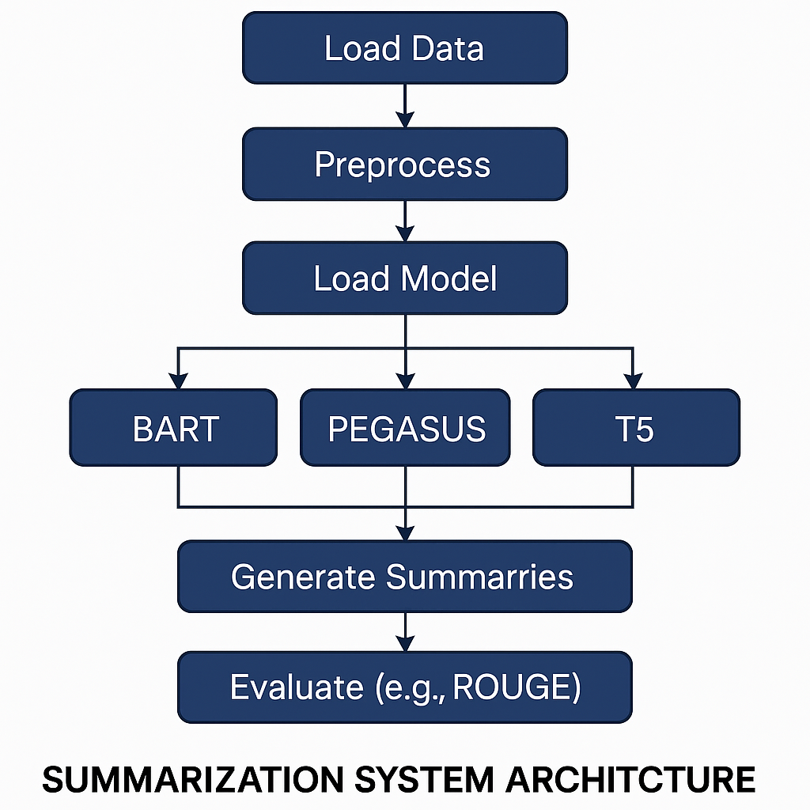
BLOCK DIAGRAM OR FLOW DIAGRAM

Slide 15
Preprocessing Techniques
Data Loading
  A stratified subset of the BBC News Summary dataset is loaded.
  Articles are categorized into short, medium, and long based on token length to support length-sensitive processing.
Text Normalization
  Conversion of all text to lowercase to reduce vocabulary sparsity.
  Ensures uniform representation across different models.
Tokenization
  Text is segmented into tokens using model-specific tokenizers (BART, PEGASUS, T5).
  Enables efficient transformer-based encoding.

Slide 16
Noise Removal
  Removal of HTML tags to eliminate markup artifacts.
  Filtering of emojis and special symbols that do not contribute to semantic meaning.
  Elimination of currency symbols and non-linguistic characters.
Whitespace Normalization
  Removal of extra spaces, tabs, and newline characters.
  Ensures consistent input formatting.
Standardization
  Uniform preprocessing applied across all models.
  Prevents preprocessing bias and ensures fair performance comparison.

Slide 17
METHODOLOGY
A dynamic routing summarization framework is designed to select the most suitable model — BART, PEGASUS, or T5 — based on article length and structure.
The dataset used is a stratified BBC News Summary dataset containing 450 articles divided into short, medium, and long categories.
Preprocessing steps: lowercasing, tokenization, and removal of HTML tags, emojis, currency symbols, and extra spaces for data uniformity.
Each model is fine-tuned using the Hugging Face Transformers library, ensuring efficient GPU-based execution in Google Colab.
Evaluation Metrics: ROUGE (lexical) and BERT Score (semantic) used to assess summary quality and coherence.

Slide 18
Dataset Loading & Batch Processing
Dataset Loading
The system uses a stratified BBC News Summary dataset containing 450 articles.
The dataset is stored in CSV format and loaded using Pandas.
Each article is labeled using a length_bucket attribute:
  Short
  Medium
  Long
Stratification ensures balanced representation of different document lengths during training and evaluation.
A sanity check using frequency counts verifies equal distribution across categories.

Slide 19
Batch Processing of Articles
Articles are processed in mini-batches instead of individually.
Batch processing:
  Improves GPU utilization
  Reduces memory overhead
  Speeds up inference and evaluation
Each batch is tokenized using model-specific tokenizers.
Padding and truncation are applied to handle variable-length inputs.
Token length limits ensure compatibility with transformer constraints.

Slide 20
Frameworks, Algorithms, and Tools:
Frameworks Used: Hugging Face Transformers, PyTorch, Google Colab (NVIDIA Tesla T4 GPU).
Algorithms Implemented:
BART – Sequence-to-sequence transformer combining bidirectional encoding and autoregressive decoding.
PEGASUS – Gap-sentence generation (GSG) pretraining for abstractive summarization.
T5 – Text-to-text transfer transformer reformulating summarization as a text-generation task.
Decoding Strategy: Beam Search (width = 5), Length Penalty = 1.2, No Repeat N-Gram Size = 3 to ensure fluent and non-redundant summaries.

Slide 21
IMPLEMENTATION
The project was implemented using Python and Hugging Face Transformers within Google Colab, enabling GPU acceleration and efficient fine-tuning of summarization models.
Data preprocessing, training, and evaluation were executed in modular stages for better scalability and debugging.
The summarization system dynamically selected BART, PEGASUS, or T5 models based on the input document’s token length.
Evaluation scripts were implemented to compare ROUGE and BERT Score metrics for lexical and semantic accuracy.

Slide 22
Environment & Pipeline
The system was implemented using Python and Hugging Face Transformers, ensuring compatibility with state-of-the –art transformer models.
Google Colab with NVIDIA Tesla T4 GPU was used to support efficient fine-tuning and inference.
The implementation followed a modular pipeline architecture, separating:
Data loading
Preprocessing
Model execution
Evaluation

Slide 23
Model Execution
A dynamic routing mechanism selected BART, PEGASUS, or T5 based on the input document’s token length.
Each model was executed under uniform preprocessing and decoding constraints to ensure fair comparison.
Beam search decoding with length penalty and repetition control was applied during inference.
Evaluation scripts computed:
  ROUGE-1, ROUGE-2, ROUGE-L for lexical overlap
  BERTScore (F1) for semantic similarity

Slide 24
Software Specifications:
Operating System: Windows 10 / Google Colab Environment
Programming Language: Python 3.10
Libraries & Frameworks: Transformers, PyTorch, NLTK, NumPy, Pandas, Matplotlib
Development Tools: Google Colab, Jupyter Notebook, GitHub
Evaluation Metrics: ROUGE-L, BERT Score
Hardware Specifications:
Processor: Intel Core i5 or above
RAM: Minimum 8 GB (16 GB recommended)
Storage: Minimum 10 GB free space

Slide 25
Challenges Faced and Solutions:
Challenge: Model instability and memory overflow during fine-tuning large datasets.
Solution: Used gradient accumulation and reduced batch sizes to stabilize training.
Challenge: Semantic loss in generated summaries.
Solution: Introduced length penalty tuning and beam search decoding to improve fluency.
Challenge: Inconsistent evaluation results due to token limit mismatch.
Solution: Standardized token lengths and preprocessing across all models.
Challenge: Managing multiple summarization models and ensuring smooth execution when users select one or more models for comparison.
Solution: Designed a user-controlled selection interface allowing manual choice between BART, PEGASUS, and T5 models, enabling flexible testing and efficient performance comparison within a single framework.

Slide 26
RESULTS & ANALYSIS
Evaluation Methodology:
Performance evaluated using lexical metrics (ROUGE-1, ROUGE-2, ROUGE-L) and semantic metric (BERT Score F1).
Models tested on 450 BBC News articles — 150 each from short, medium, and long categories.
Hyperparameters such as beam width, repetition penalty, and length normalization were tuned individually for each model.
Results were averaged to ensure fair and consistent comparison.

Slide 27
Quantitative Comparison:
Model | ROUGE-1 | ROUGE-2 | ROUGE-L | BERTScore(F1)
BART | 43.8 | 20.5 | 40.1 | 88.7
PEGASUS | 45.6 | 22.1 | 42.5 | 89.3
T5 | 42.3 | 19.4 | 38.7 | 88.1

Slide 28
Quantitative Performance Analysis
The performance of BART, PEGASUS, and T5 was evaluated using ROUGE-1, ROUGE-2, ROUGE-L, and BERTScore (F1) across short, medium, and long article categories.
PEGASUS achieved the highest overall ROUGE and BERTScore values, particularly for short and medium-length articles, indicating strong abstraction and semantic fidelity.
BART showed consistent ROUGE-1 and ROUGE-L scores, with best performance on medium-length articles, reflecting its ability to retain contextual depth.
T5 recorded comparatively lower ROUGE scores, especially for long articles, due to 512-token input limitations, but maintained stable BERTScore, indicating semantic preservation.
Across all models, BERTScore values remained above 0.84, confirming strong semantic alignment with reference summaries.

Slide 29
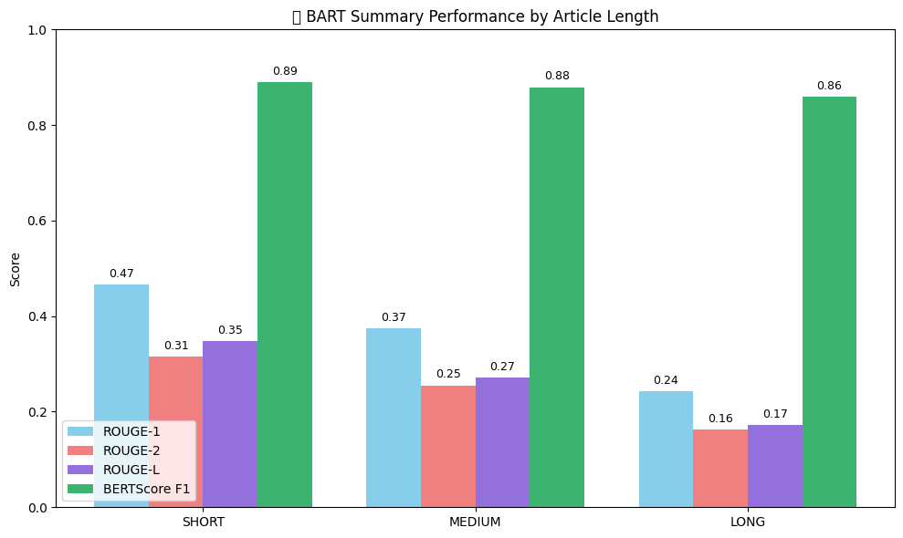

Slide 30
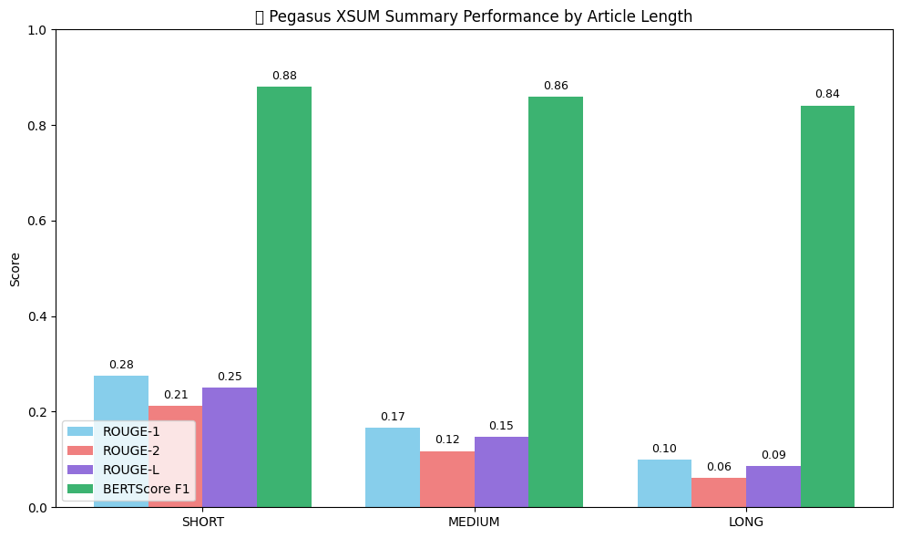

Slide 31
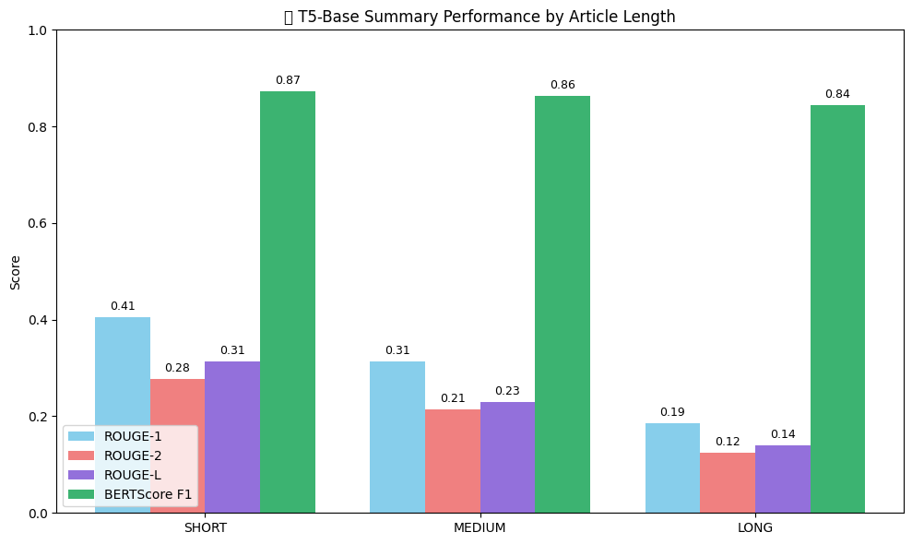

Slide 32
Graph-Based Observations & Interpretation
Graphical analysis demonstrates a clear performance variation with article length.
For short articles:
  PEGASUS AND BART perform strongly in both ROUGE and BERTScore.
  PEGASUS produces more concise summaries with higher abstraction.
For medium articles:
  BART achieves peak performance, balancing compression and contextual coverage.
For long articles:
  All models show a decline in ROUGE scores due to token truncation.
  Semantic scores remain stable, indicating preserved core meaning.

Slide 33
Results and Discussion:
PEGASUS achieved the best performance in both ROUGE and BERTScore, showing strong semantic fidelity and concise summarization.
BART performed efficiently for medium-length inputs but sometimes generated verbose outputs reducing ROUGE-2 precision.
T5 delivered lower ROUGE values due to input token limitations, but maintained good semantic accuracy.
Overall, PEGASUS excelled in balancing brevity, coherence, and contextual coverage.
These results highlight that model selection should depend on task requirements, not just raw metric values.

Slide 34
CONCLUSION and FUTURE SCOPE
Conclusion:
PEGASUS achieved the best summarization performance, producing concise and semantically accurate summaries, as reflected by higher ROUGE and BERTScore values.
BART generated contextually rich summaries, performing especially well on medium-length inputs, but showed slight verbosity on longer documents.
T5 maintained semantic consistency across varied input lengths, despite lower ROUGE scores caused by input token limitations
The proposed length-sensitive, multi-model framework effectively balances brevity, coherence, and contextual coverage across different document sizes.
Overall, the study demonstrates that model selection should be task- and input-dependent, rather than relying on a single summarization model or raw metric values.

Slide 35
FUTURE SCOPE:
Extend the framework to domain-specific datasets such as legal, medical, or academic texts to improve adaptability and real-world applicability.
Implement fully automated input-aware dynamic model routing, allowing real-time selection of the optimal summarization model based on document characteristics.
Apply model compression and knowledge distillation techniques to reduce computational cost while maintaining summarization quality.
Explore long-context transformer architectures to better handle very long documents without truncation.

Slide 36
REFERENCES
M. Azam and F. Ahmed, “Extractive Summarization Using Enhanced Graph Models,” *International Journal of Artificial Intelligence*, vol. 34, no. 2, pp. 101–115, 2025.
M. Salam, R. Alfarraj, and M. Alweshah, “MS-GATS: A Multi-Sentence Graph Attention Network for Arabic Text Summarization,” in *Proc. IATMSI*, 2024
S. Rautaray, S. K. Singh, and H. Saini, “CSO–HHO Optimized Extractive Summarization Technique,” *Elsevier Expert Systems with Applications*, vol. 213, 2025.
P. Satpute and P. Kulkarni, “Hybrid TextRank with Word2Vec for Extractive Summarization,” *Springer AI Society*, 2025.
M. Khan et al., “Survey of Abstractive Summarization Using Transformers,” *ACM Computing Surveys*, vol. 56, no. 1, pp. 1–35, 2023.

Slide 37
M. Awais and R. M. A. Nawab, “Abstractive Urdu Summarization Using LSTM-Transformer Hybrid,” *IATMSI Transactions*, vol. 9, no. 2, pp. 89–100, 2024.
I. Khan, M. Rahman, and M. Almahdawi, “Arabic Text Summarization via Enhanced Lexical Cohesion,” in *Proc. IEEE NLP*, 2025.
R. Naik et al., “EffSum: Efficient Transformer Summarization for Indian News,” *Elsevier Information Processing Management*, vol. 62, 2025
M. Kadhim, H. Ali, and H. Shukur, “Feature-Based Sentence Scoring for Summarization,” *Springer Soft Computing*, 2025.
A. Elsaid, M. Alghamdi, and H. Alqarni, “Arabic Text Summarization: A Comprehensive Review,” *ACM Transactions on Asian and LowResource Language Information Processing*, vol. 21, no. 3, 2022.

Slide 38
R. Kumar and A. Joshi, “Legal Text Summarization Using Discourse and Abstraction,” *IATMSI Transactions*, vol. 10, no. 1, pp. 33–46, 2025.
A. Hegde, “Sentiment-Guided Medical Literature Summarization,” *IEEE Transactions on Computational Social Systems*, vol. 9, no. 2, pp. 200–211, 2022
S. Pisano, “Rule-Based Summarization of Italian Tax Law,” in *Proc. ` Springer LegalTech*, 2023.
R. Singh ad R. Rathi, “Clinical Summarization Using Multi-Head Attention,” *Springer Health Informatics Journal*, vol. 38, no. 1, pp. 15–27, 2025
Y. Zhang et al., “Multi-Modal Summarization of Educational Lectures,” *IEEE Transactions on Learning Technologies*, vol. 18, no. 2, pp. 123–134, 2025.

Slide 39

QUESTIONS and ANSWERS
We appreciate your time and interest.
Now we would like to open floor for questions and answers

Slide 40

ACKNOWLEGEMENTS
We sincerely thank our guide K.V NARASIMHA REDDY SIR for their valuable guidance, encouragement, and continuous support throughout the project.
We would like to thank the Head of the Department and faculty of Computer Science and Engineering, Narasaraopeta Engineering College, for providing essential resources and technical support.
We extend our gratitude to the Department of Computer Science and Engineering, Narasaraopeta Engineering College, for providing the required infrastructure and opportunity to present this work.
For any queries or further information, please reach out to:skbuddu786786@gmail.com

